Slide 1
Microsoft Teams for Support/Champions Part 1
Teams Training | November 2021
DESA Enterprises, LLC
https://www.linkedin.com/company/desaenterprises
http://aka.ms/TipTuesday

Slide 2
Agenda
Teams Interface and Common Terms
Other Interface Areas
Browser vs Client Differences
Closing/Restarting Teams client
Changing Quickly (this is Microsoft’s fastest cadence of changes)
How to get to SharePoint (behind the scenes/extra functions)
OneNote for Channel as a Tab
Resources
Some Common Teams FAQ
DESA Enterprises, LLC
https://www.linkedin.com/company/desaenterprises
http://aka.ms/TipTuesday

Slide 3

Introduction to Teams
What’s Microsoft Teams
Brings together all chat, content, conversations and applications into one workspace
Cloud based – available anywhere on any device
You can benefit from Office 365 security & Compliance
It helps you communicate and collaborate (use Office 365 apps that include Excel, Word, OneNote, Planner etc. and share documents) with your colleagues
You can also connect to 3rd party apps
DESA Enterprises, LLC
https://www.linkedin.com/company/desaenterprises
http://aka.ms/TipTuesday
Notes:
Teams is a hub for many Microsoft communication, collaboration tools as well as other Microsoft and 3rd party applications and services.
It’s available as an application or a web-based service that you can access from anywhere, anytime
It ties into the Office 365/Microsoft 365 services like SharePoint Online, Microsoft 365 Groups
Learn about Microsoft 365 Groups - Office Support

Slide 4
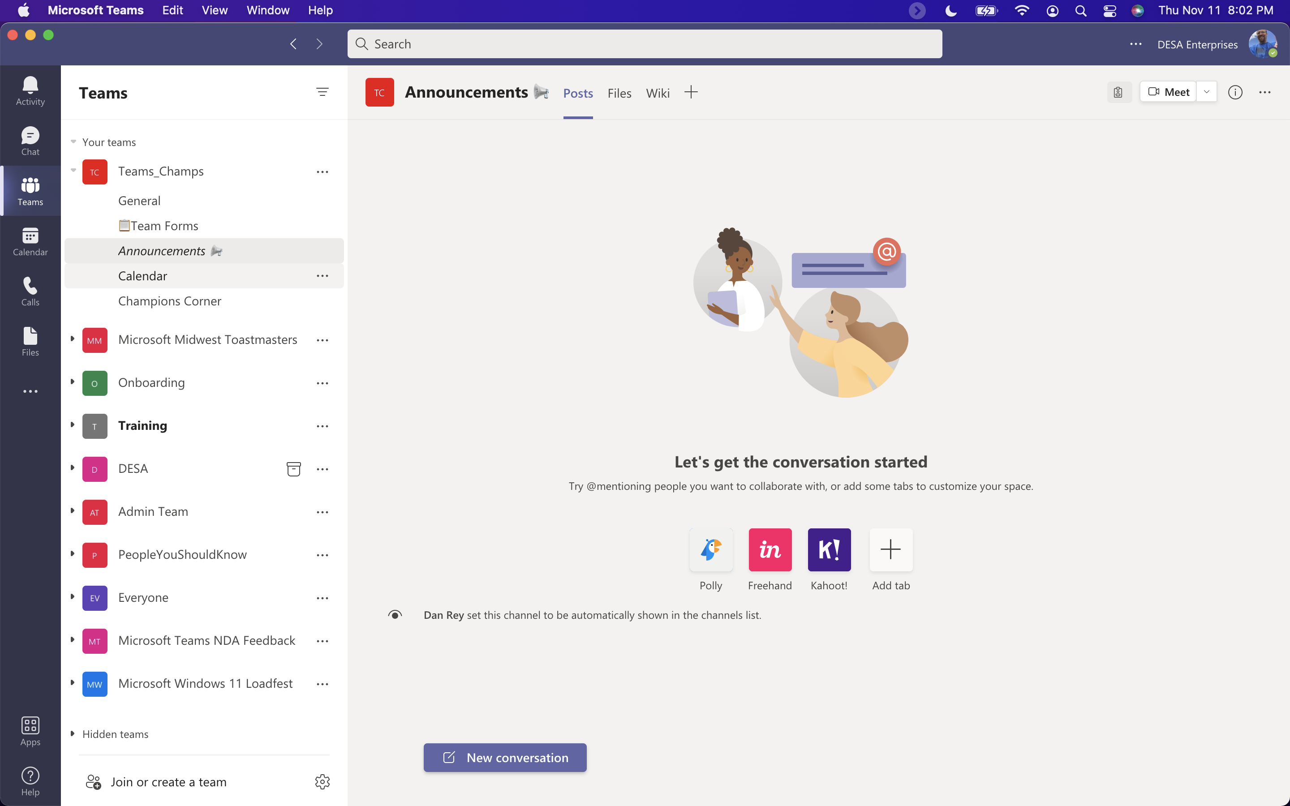
Three “sections” to the Teams Application
The Teams application can be broken into three major sections
Navigation pane
List pane
Content pane
Unlike other office applications (where you have a ribbon on the top), Teams leverages a different layout and we need different terms to identify these areas of the interface.
DESA Enterprises, LLC
https://www.linkedin.com/company/desaenterprises
http://aka.ms/TipTuesday
Notes:
Common language for the Teams interface is important when supporting it. Users won’t be familiar with this interface because there isn’t a ribbon like the rest of the Office apps (introduced in Office 2007) what we are using to refer to various areas of the screen – here is our recommendation
Microsoft Teams: glossary of Teams terms - Content Cloud (contentandcloud.com) – this is what we are using other references/resources below
Use a screen reader to explore and navigate Microsoft Teams - Office Support – calls the sections App Bar, List Pane and Content Pane (exception for Calendar) – navigation pane (my favorite description) left rail or side-rail are also used to describe far left navigation
Chat, teams, channels, & apps in Microsoft Teams - Microsoft Teams | Microsoft Docs
Pin Apps to the Left-Hand Rail in Microsoft Teams – buckleyPLANET
Full Yammer experience in Microsoft Teams with Yammer Communities App – Tom Talks
Use a screen reader to explore and navigate Microsoft Teams - Office Support

Slide 5
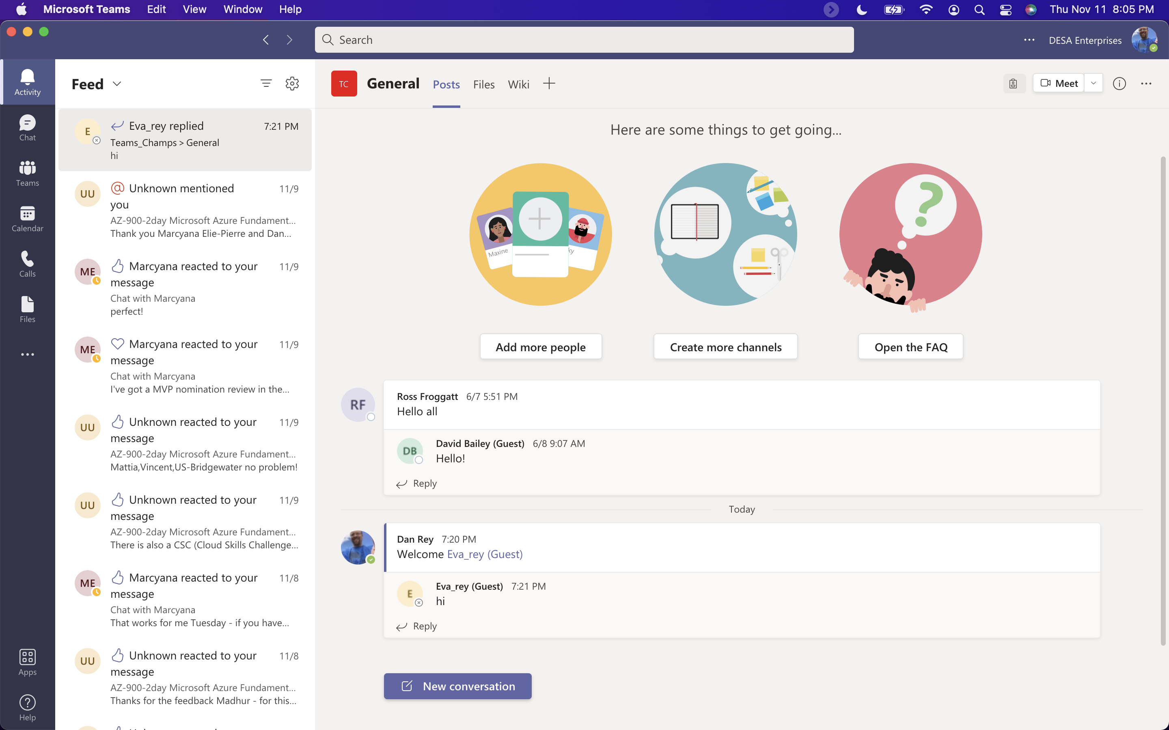
Activity View
Should be the first of the items in the upper leftward corner
(you can drag/drop and change these items in the navigation pane as an advanced user)
Like your inbox (what’s happened since you were last in Teams
DESA Enterprises, LLC
https://www.linkedin.com/company/desaenterprises
http://aka.ms/TipTuesday
Notes:
Screenshots from Like your inbox
There is a filter and a gear in the list pane

Slide 6
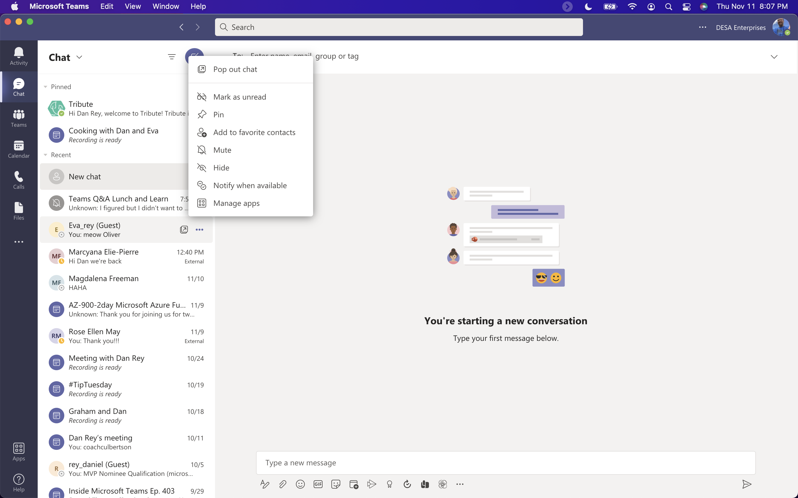
Chat View
Next item on the far left – chat (this will replace Jabber)
Chats can be within the Teams window or “popped out” into separate windows
TIP: type /POP on the search bar in the top middle of the Teams application!
DESA Enterprises, LLC
https://www.linkedin.com/company/desaenterprises
http://aka.ms/TipTuesday
Notes:
Screenshots from
Like Jabber
There is a filter and a new chat icon in the list pane – you can “pop out” a chat by double clicking or to the far right in the content pane

Slide 7
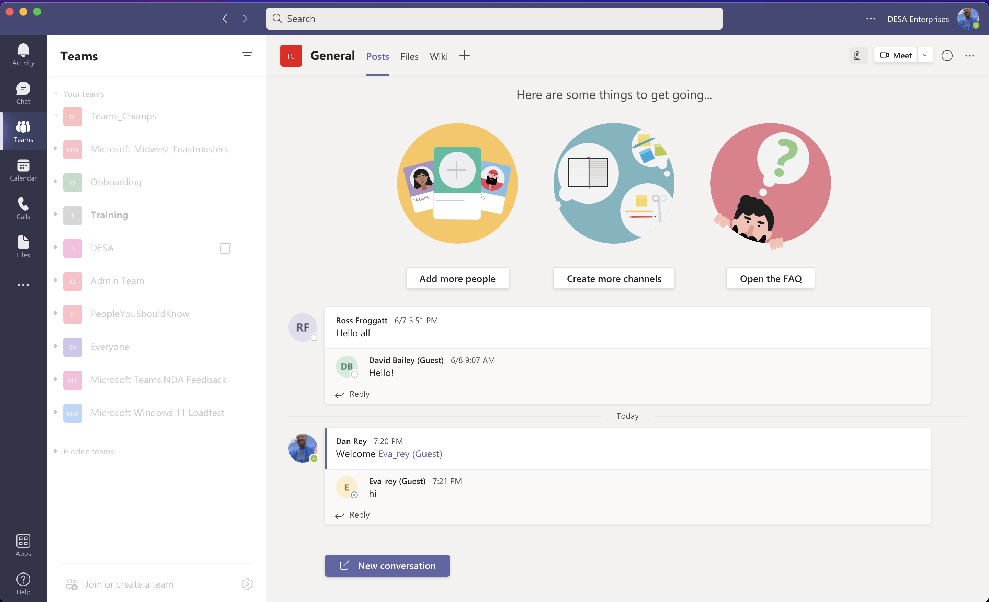
Teams View
Teams you are a member of are listed here
Multiple teams/multiple channels
You can reorder your teams, show/hide and control this list so that it’s managable
DESA Enterprises, LLC
https://www.linkedin.com/company/desaenterprises
http://aka.ms/TipTuesday
Notes:
Screenshots from
Teams view – you may have multiple teams and Teams have Channels listed below them
There is a filter in the list pane – posts here are like chats, but all members of the team see these conversations! As new members are added all the history is there
Think of the Teams Channels as a mutually agreed to Folder structure in your email – you can be a piler (think of the General channel as your Inbox for this particular team) and leave everything in your Inbox or you can agree as a team to be filers and put conversations, files, notes, etc. in Channels that you can see in the list view

Slide 8
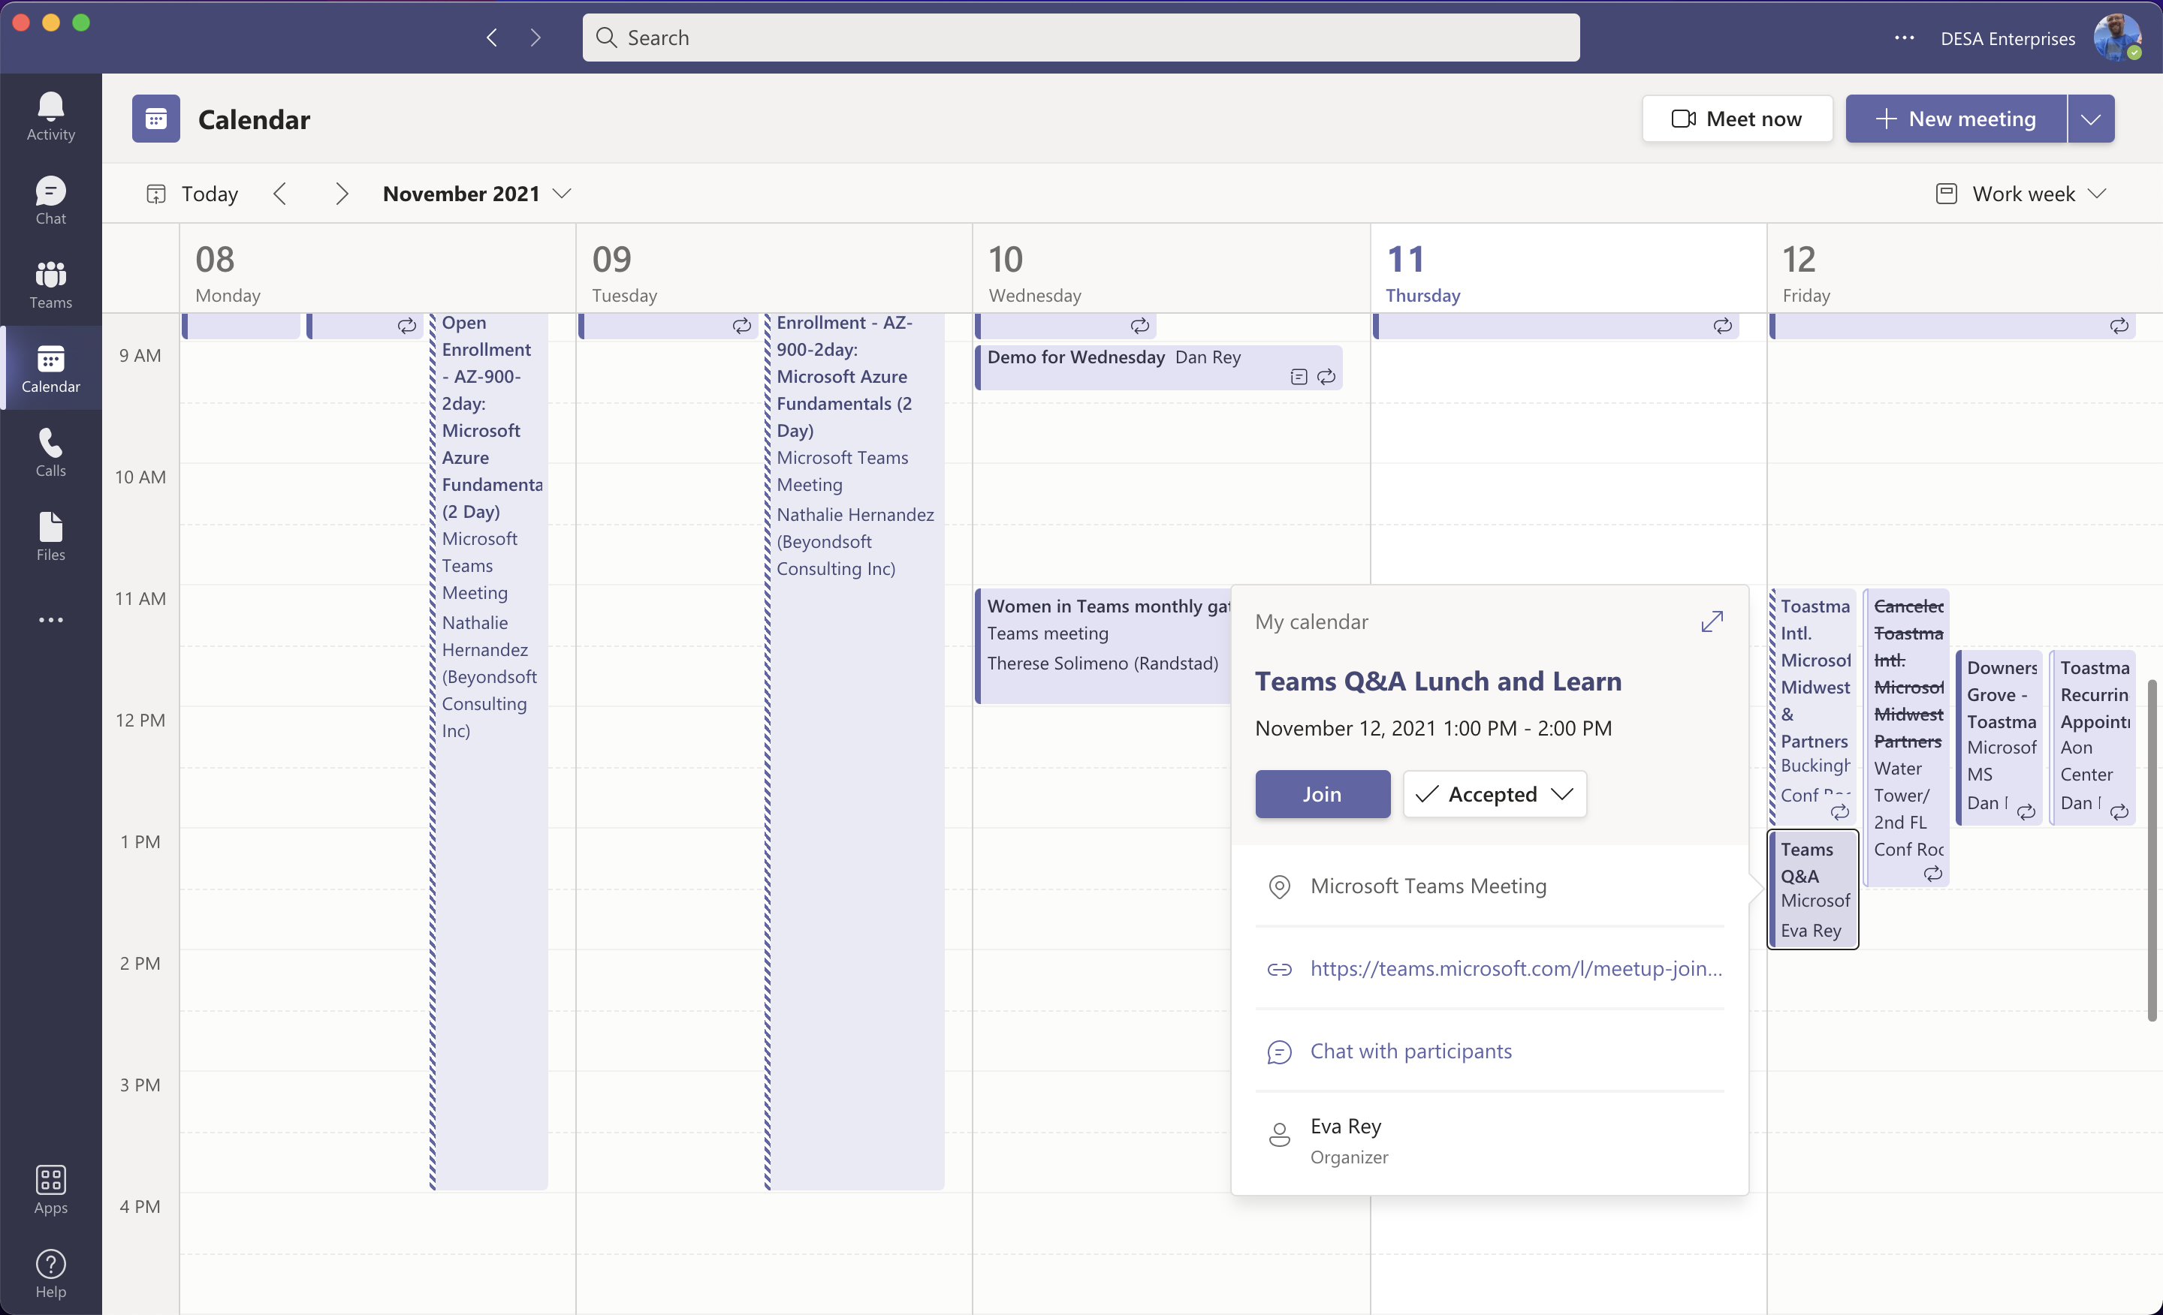
Calendar View
This may be in a different order (and users can change order)
5 day view by default, day view available as well
Day view and full week views available – it’s the same as your Outlook calendar!
DESA Enterprises, LLC
https://www.linkedin.com/company/desaenterprises
http://aka.ms/TipTuesday
Notes:
Screenshots from
Like your Outlook Calendar without having to go to/open Outlook!
No list pane, just a 5 day calendar by default
You have some customization here, but limited compared to Outlook
PERFECT FOR viewing your appointments, joining meetings, etc.

Slide 9
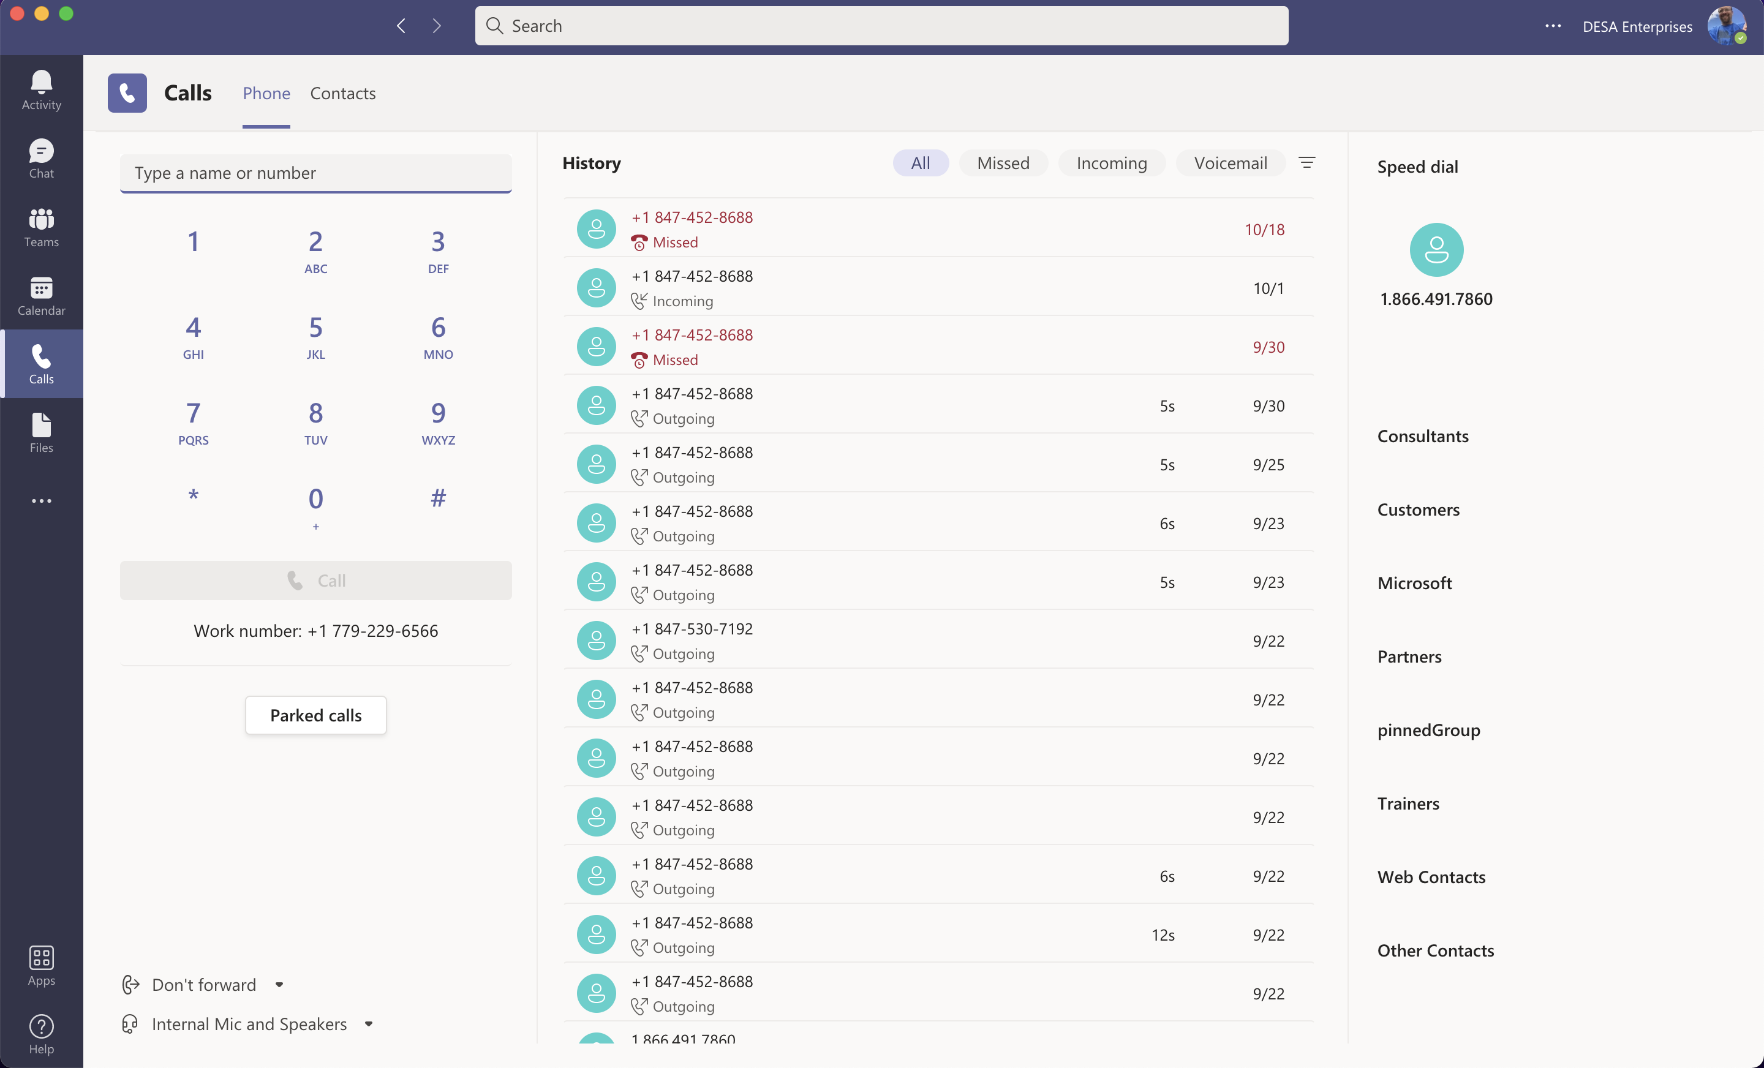
Calls View
Calls from Teams are here (I have a dial pad on mine)!
Calls with Teams show up here
DESA Enterprises, LLC
https://www.linkedin.com/company/desaenterprises
http://aka.ms/TipTuesday
Notes:
Screenshots from
Files in your Teams and Files in your OneDrive!
Super useful if you wish to look for files regardless of location

Slide 10
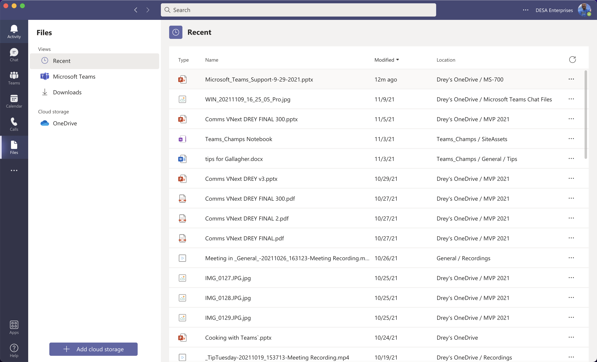
Files View
Files from Teams and OneDrive are listed here!
Recent (should show files in Office 365 you have recently used)
All files – personal (OneDrive) and Teams listed here
DESA Enterprises, LLC
https://www.linkedin.com/company/desaenterprises
http://aka.ms/TipTuesday
Notes:
Screenshots from
Files in your Teams and Files in your OneDrive!
Super useful if you wish to look for files regardless of location

Slide 11
Other Interface Areas
DESA Enterprises, LLC
https://www.linkedin.com/company/desaenterprises
http://aka.ms/TipTuesday

Slide 12
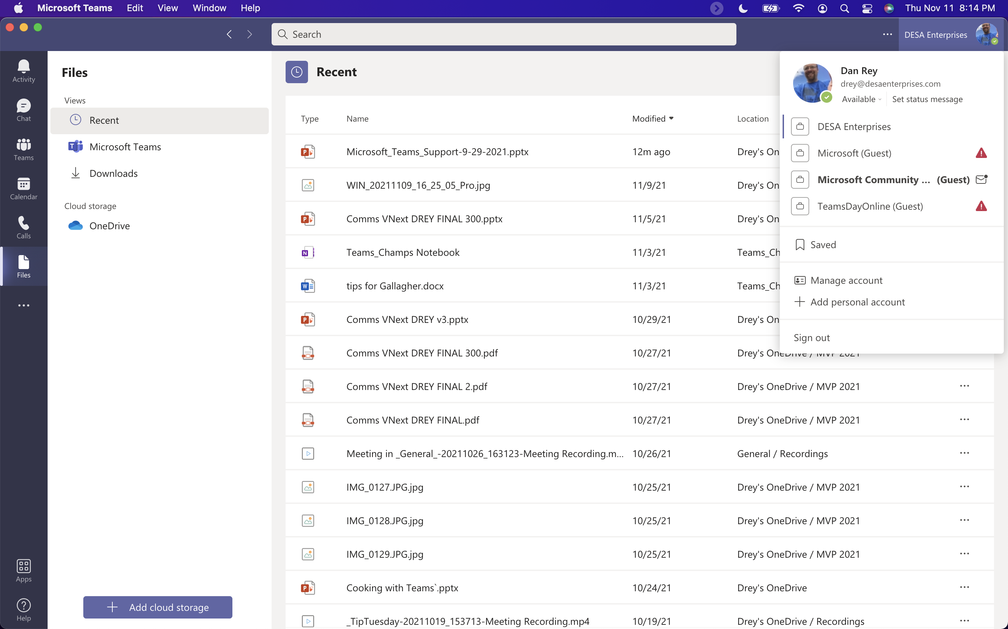
Other Areas of the Interface – Menu Bar at the top
In the upper right is your picture or initials – clicking here can let you change the font size used in Teams!!!!)
Menu bar across the top of the application – far right is your picture or initials
Three dots to the left of your picture/initials
Search in the center
Back and forward on the far left
DESA Enterprises, LLC
https://www.linkedin.com/company/desaenterprises
http://aka.ms/TipTuesday
Notes:
Lots of stuff hidden under chat head that users might want to know about – this is not what I would consider “discoverable” – no indication to click to change

Slide 13
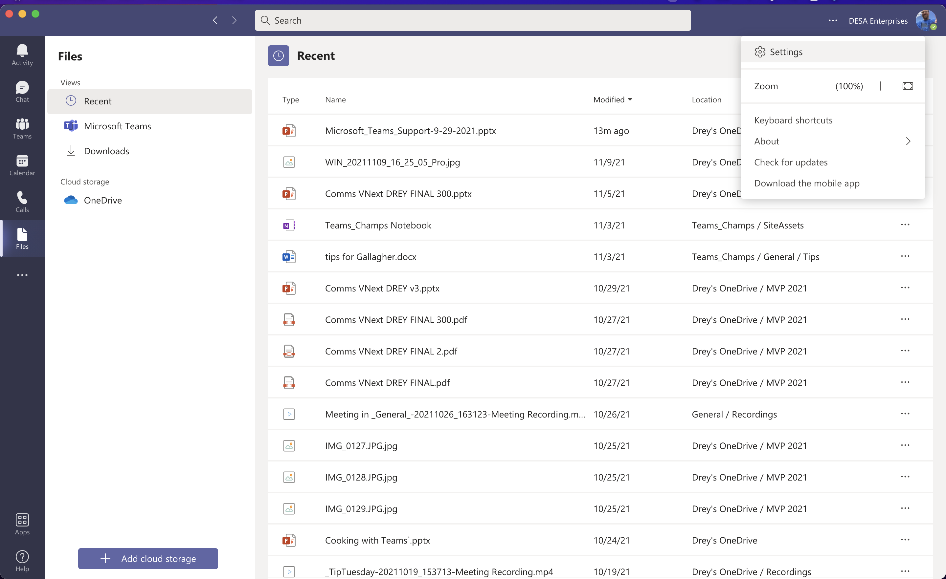
Settings - Devices
Troubleshooting headsets, speaker/mic combination and video settings available)
You can also decide how many notifications you receive from Microsoft Teams!
DESA Enterprises, LLC
https://www.linkedin.com/company/desaenterprises
http://aka.ms/TipTuesday
Notes:
Under your picture – Settings - Devices

Slide 14
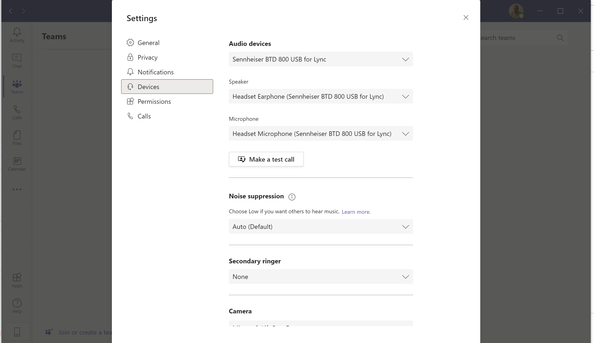
Settings - Devices
Devices – includes a new feature – noise suppression!
Off, Auto, Low and High are choices
DESA Enterprises, LLC
https://www.linkedin.com/company/desaenterprises
http://aka.ms/TipTuesday
Notes:
Common settings to troubleshoot for users

Slide 15
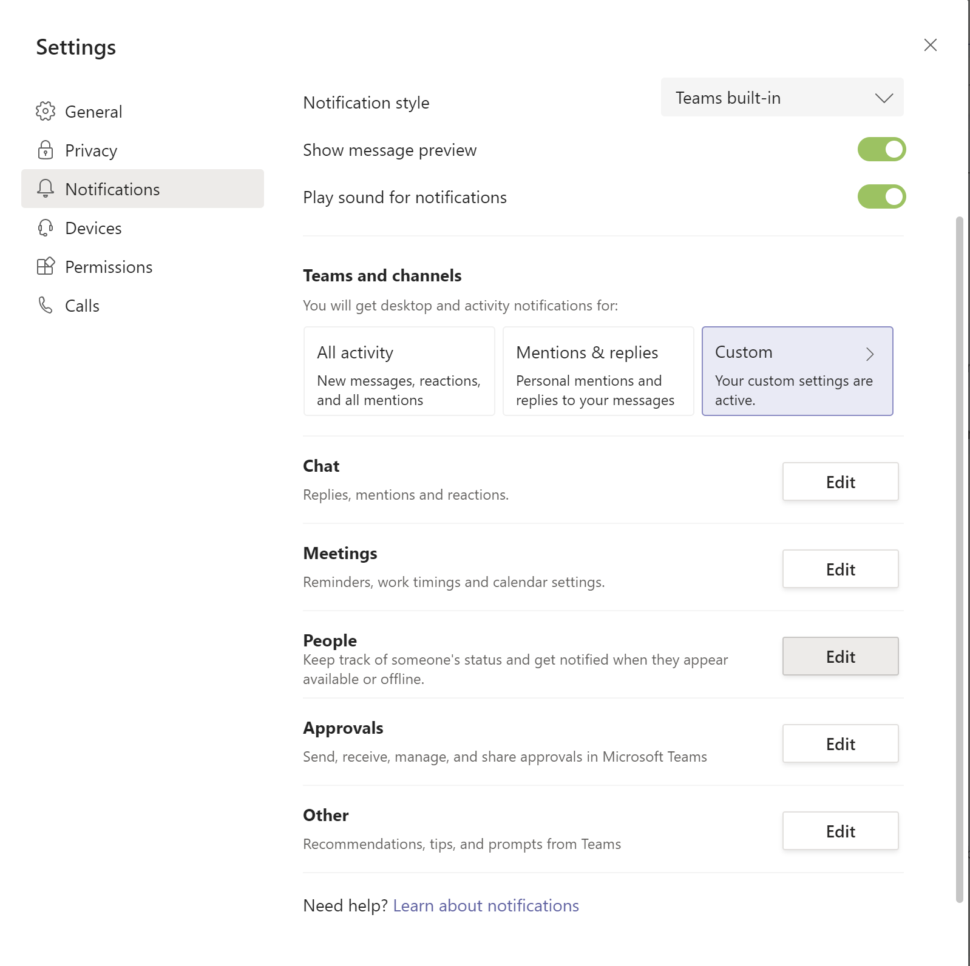
Settings – Notifications - People
Setting the notifications for people lets you know when they become available in Teams!
Notifications is where you control how Teams notifies you of missed activity, meetings people and their status, etc.
DESA Enterprises, LLC
https://www.linkedin.com/company/desaenterprises
http://aka.ms/TipTuesday
Notes:
When you have users that feel Teams is too “noisy” – too many banner and feed messages

Slide 16
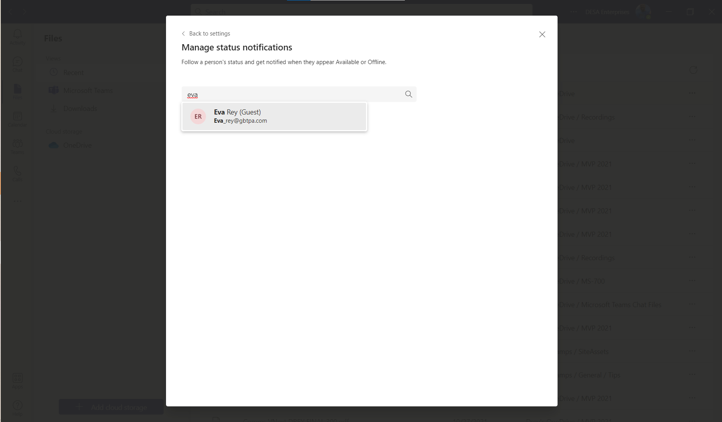
Settings – Notifications - People (cont.)
Super helpful if you know they are in a meeting/on do not disturb
Type in someone’s name and you can get their status notifications when they become free in Teams
DESA Enterprises, LLC
https://www.linkedin.com/company/desaenterprises
http://aka.ms/TipTuesday
Notes:
Setup someone critical to let you know their status (a manager/lead for example)

Slide 17
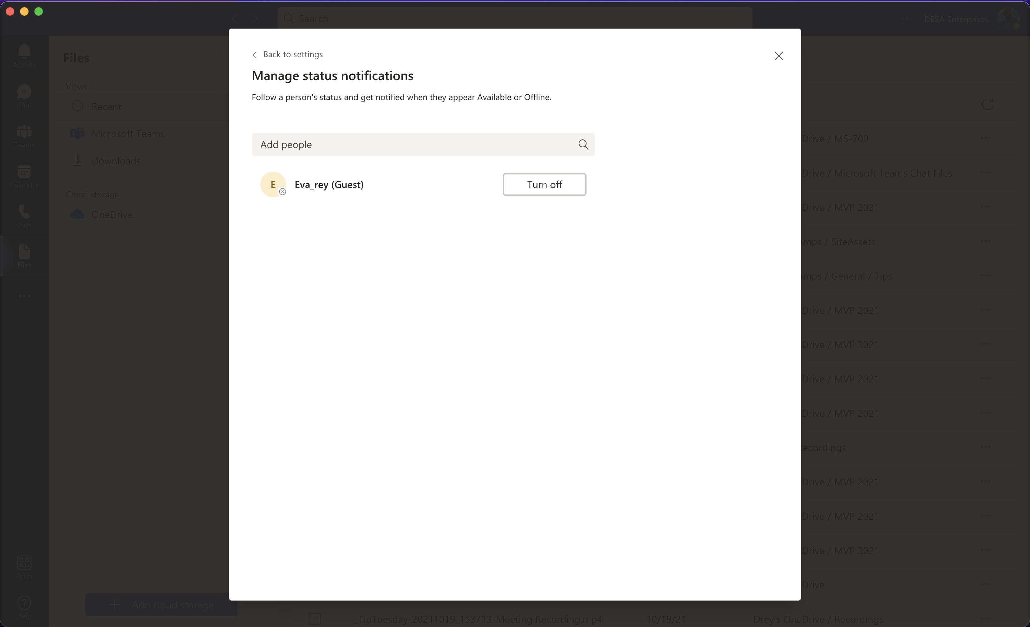
Settings – Notifications - People (cont.)
You get a list of everyone set for status changes here
You can manage the list (turn off users you no longer want to be notified of status changes)
DESA Enterprises, LLC
https://www.linkedin.com/company/desaenterprises
http://aka.ms/TipTuesday
Notes:
You can change these over time

Slide 18
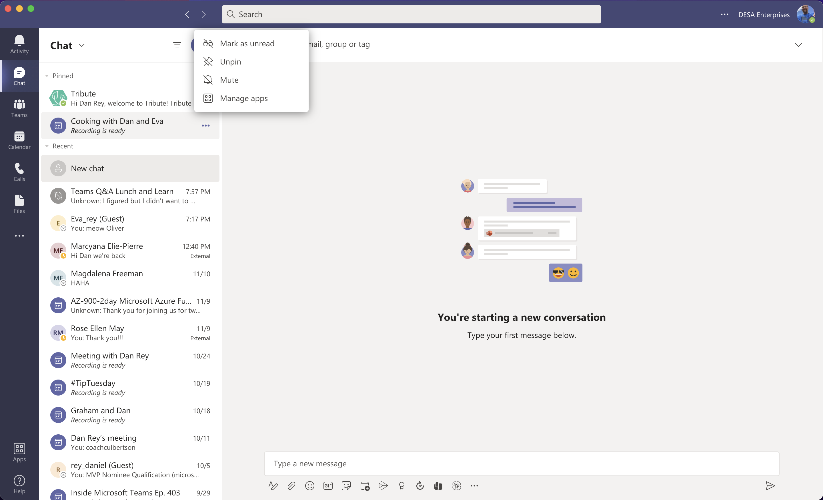
Other Interface Areas
Key Takeaways
Changing the font size in Teams is not intuitive (it’s under your picture in the upper right or CTRL + and CTRL -)
Settings are under you photo (not intuitive until you know about it)
Anywhere you see the three dots (it’s like a menu)
DESA Enterprises, LLC
https://www.linkedin.com/company/desaenterprises
http://aka.ms/TipTuesday

Slide 19
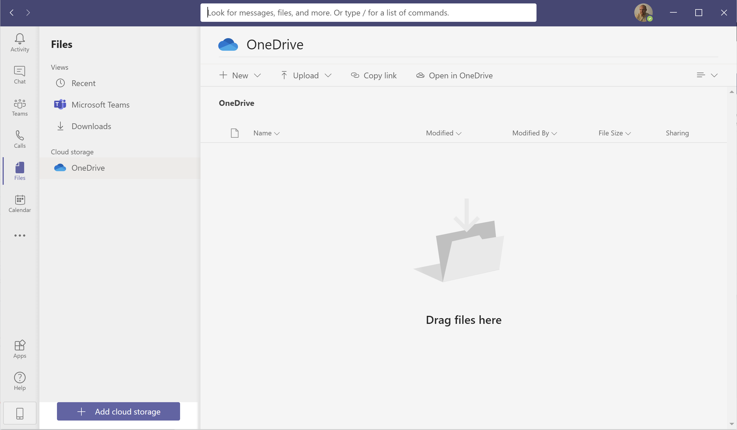
Search in the middle of the Menu Bar
Lots of great tricks and shortcuts available here!
Search for just about anything – chats, teams, channels
DESA Enterprises, LLC
https://www.linkedin.com/company/desaenterprises
http://aka.ms/TipTuesday

Slide 20
Browser vs Client Differences
Look almost identical
Differences are discovered when you are given instructions on where to find a setting
DESA Enterprises, LLC
https://www.linkedin.com/company/desaenterprises
http://aka.ms/TipTuesday

Slide 21
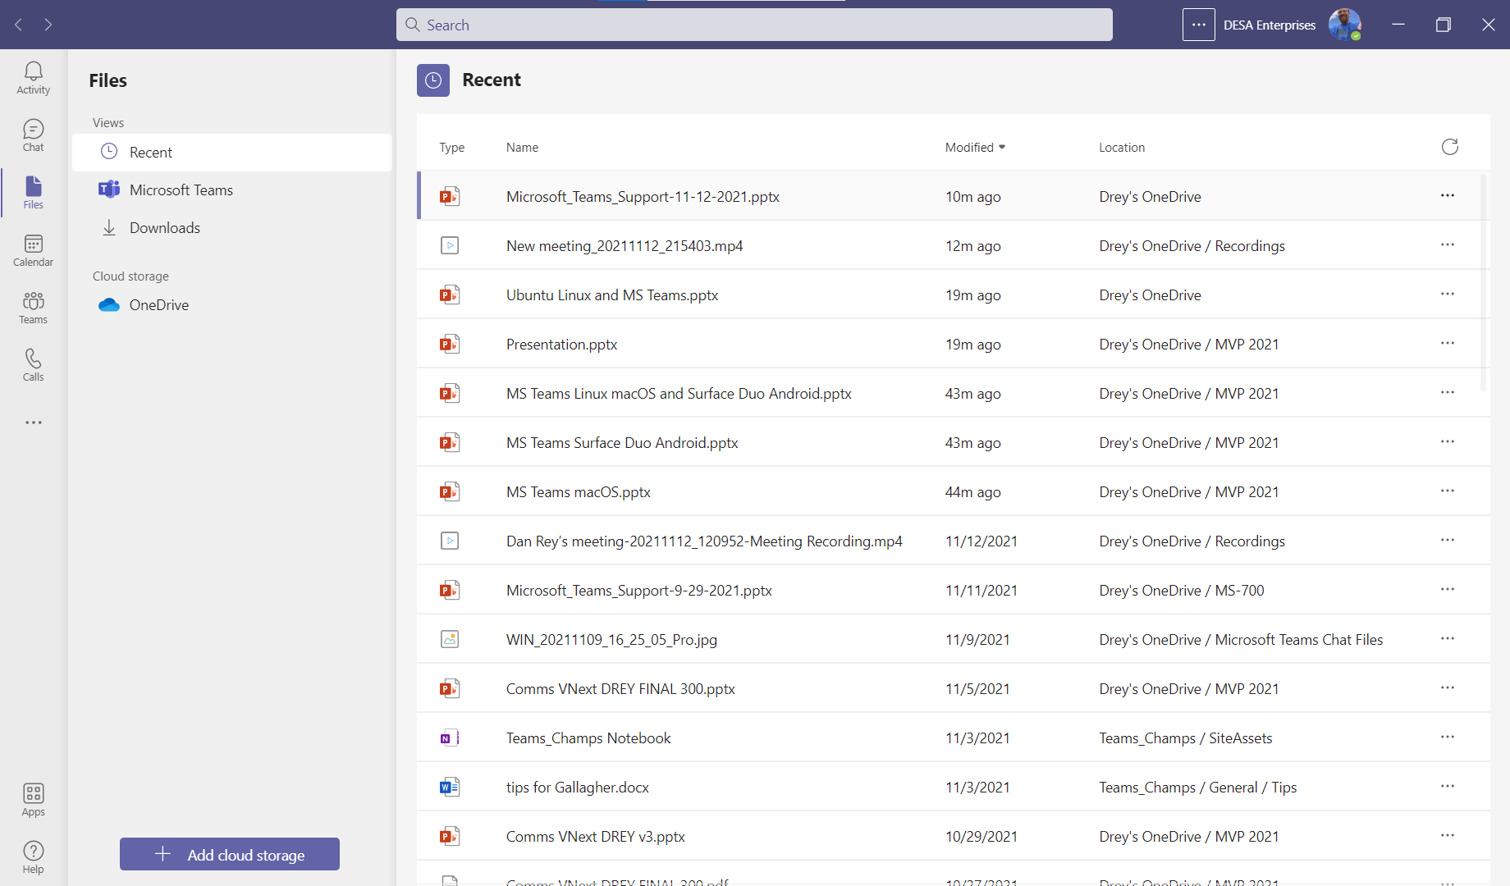
Browser vs Teams client
Teams left rail has changed in the client application (off white/gray and new icons)
Best way to tell for a user is the client doesn’t have a browser title bar
DESA Enterprises, LLC
https://www.linkedin.com/company/desaenterprises
http://aka.ms/TipTuesday
Notes:
A lot of users will end up in the browser for one reason or another – the experiences for editing, meeting and chatting are slightly different

Slide 22
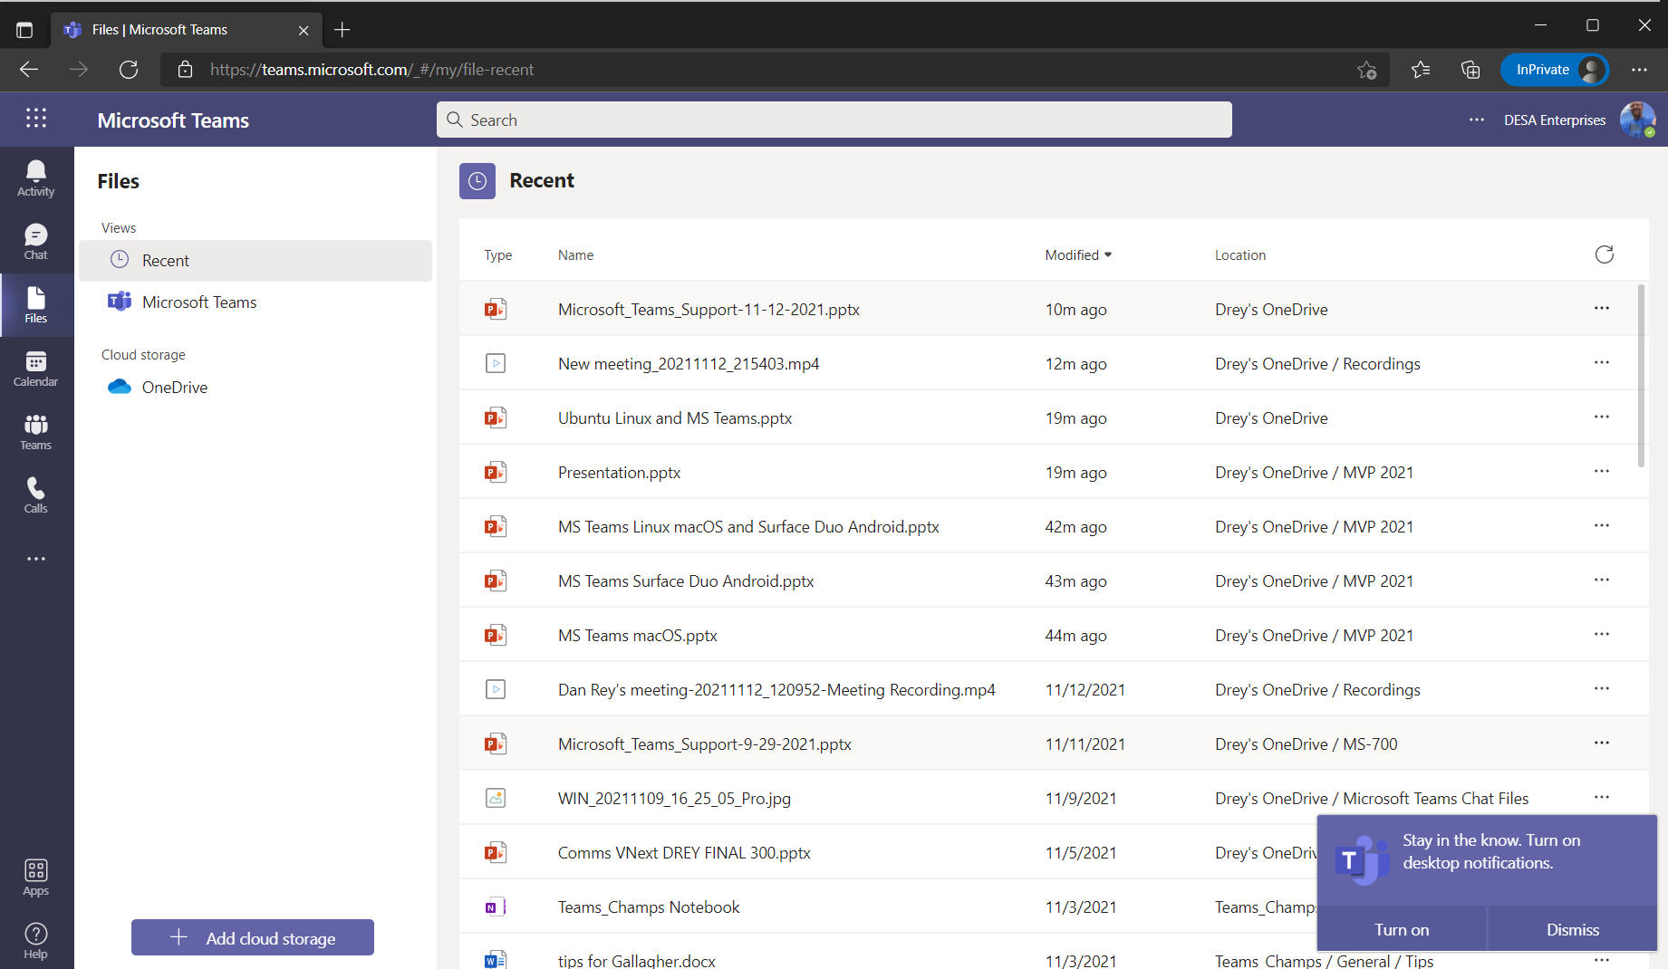
Browser vs Teams client
Microsoft Teams in a Browser has a browser window surrounding it
If they are in a browser there will be certain functions with either different or missing options (picture or their initials in the upper right hand corner – settings – devices as an example)
DESA Enterprises, LLC
https://www.linkedin.com/company/desaenterprises
http://aka.ms/TipTuesday
Notes:
Browser – look for the icon Teams is running in or the title bar (is it a browser bar with an address in it like teams.Microsoft.com? Then you are in the browser

Slide 23
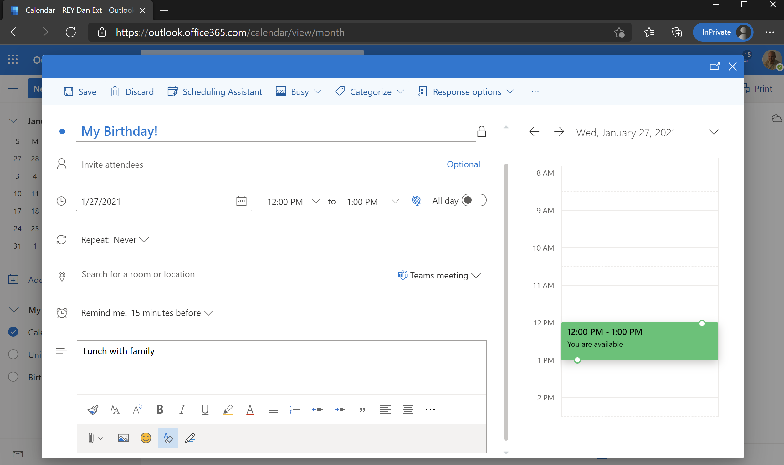
Outlook Scheduling a Meeting
Outlook is the suggested DEFAULT for people scheduling meetings
There are more features, it’s consistent with what people are doing today and unless they are leveraging a Teams feature that might be better to schedule within Teams, this is our suggestion/best practice
DESA Enterprises, LLC
https://www.linkedin.com/company/desaenterprises
http://aka.ms/TipTuesday
Notes:
Outlook is our meeting scheduling recommendation/best practice

Slide 24
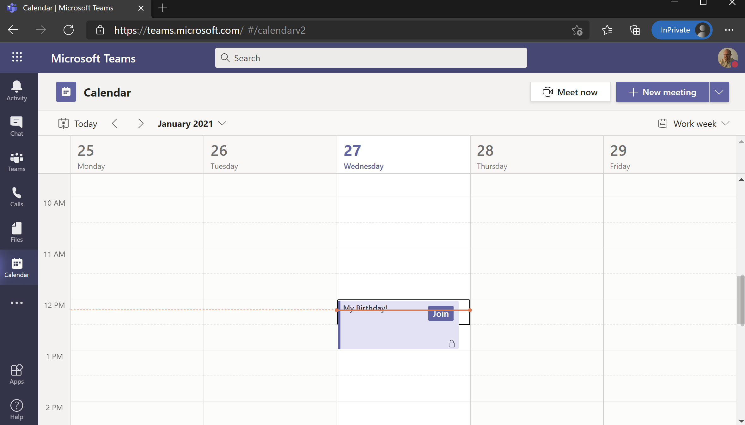
Teams – you can see your Outlook Meetings!
There are more options/control today in Outlook for scheduling a meeting, but you can see and join meetings as well as get detail from Teams
Exceptions – meeting in a Channel (will be extremely helpful with Breakout rooms functionality) and Live Events
DESA Enterprises, LLC
https://www.linkedin.com/company/desaenterprises
http://aka.ms/TipTuesday
Notes:
You can see them within Teams to join a meeting, confirm where you are next, etc.

Slide 25
Closing/Restarting Microsoft Teams
Close the application in the lower right (Notification Area)
Have the user logoff and logon again (closes everything)
DESA Enterprises, LLC
https://www.linkedin.com/company/desaenterprises
http://aka.ms/TipTuesday

Slide 26
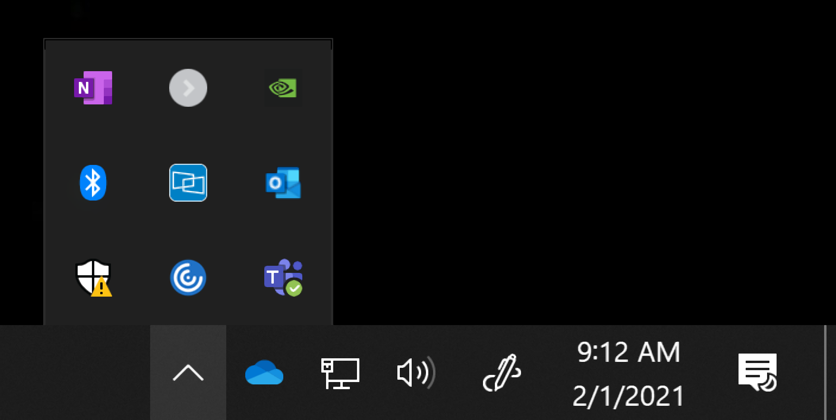
Closing/Restarting Microsoft Teams
Unlike other applications, Microsoft Teams can be “shut” or “closed”, but is still running in the notification area (bottom right hand corner of Windows 10)
Users may or may not be familiar with this section – you can decide if it would be quicker/easier to have the user logoff and logon again.
Sometimes if Teams is not behaving, restarting the application can help – this isn’t the case very often, but if someone leaves their computer logged in for long periods of time, a logoff/log back in resets a lot of things that might be causing an issue
Device defaults (audio/video) and other Windows settings can also effect Microsoft Teams, but for the most part, the settings are in the application itself, not part of Windows
DESA Enterprises, LLC
https://www.linkedin.com/company/desaenterprises
http://aka.ms/TipTuesday

Slide 27
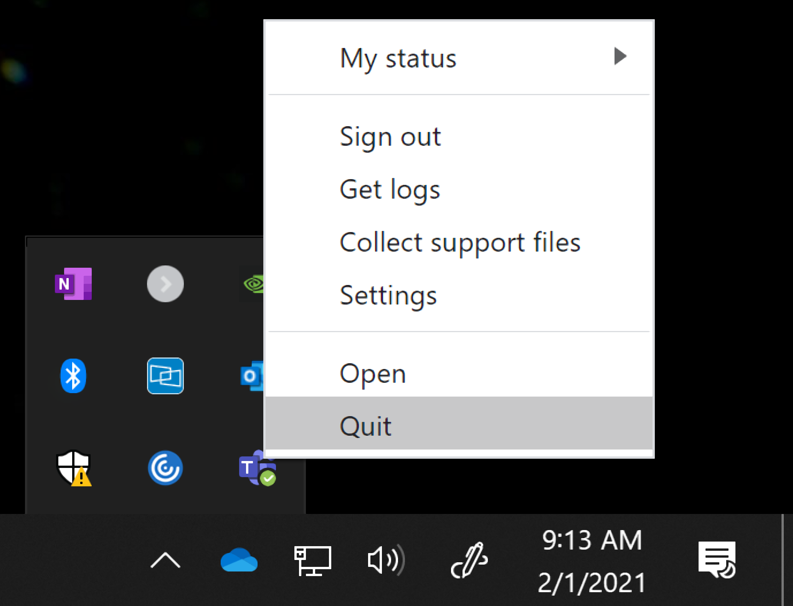
Closing/Restarting Microsoft Teams (cont.)
You can right click on the Microsoft Teams icon (you might have to hover your mouse over the ^ in the notification area if it isn’t visible) and right click to Quit the application.
I usually move the Teams icon to be visible in the notification area so it doesn’t hide in the extra applications – this is a drag/drop with your mouse/trackpad
DESA Enterprises, LLC
https://www.linkedin.com/company/desaenterprises
http://aka.ms/TipTuesday

Slide 28
Microsoft Teams is Changing on a Rapid Basis!
There are ways to stay ahead of what is in progress, being tested as well as rolling out
You wouldn’t be able to confidently say “this is exactly what it looks like” over time because the interface and features have changed
DESA Enterprises, LLC
https://www.linkedin.com/company/desaenterprises
http://aka.ms/TipTuesday

Slide 29
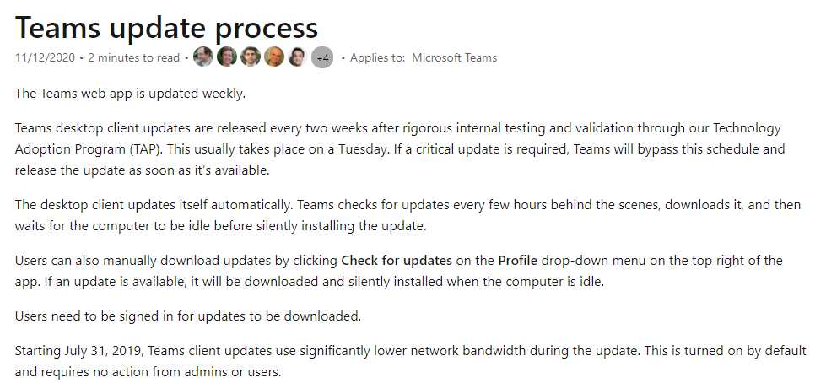
Teams is Changing – Rapidly!
Watch for updates
Keep in mind for any written/step by step instructions
Browser, app and platform differences as well
DESA Enterprises, LLC
https://www.linkedin.com/company/desaenterprises
http://aka.ms/TipTuesday
Teams updates - Microsoft Teams | Microsoft Docs
Notes:
Teams updates - Microsoft Teams | Microsoft Docs

Slide 30
Teams Files are Stored in SharePoint
A file shared in Chat
A file shared in a Team
DESA Enterprises, LLC
https://www.linkedin.com/company/desaenterprises
http://aka.ms/TipTuesday

Slide 31
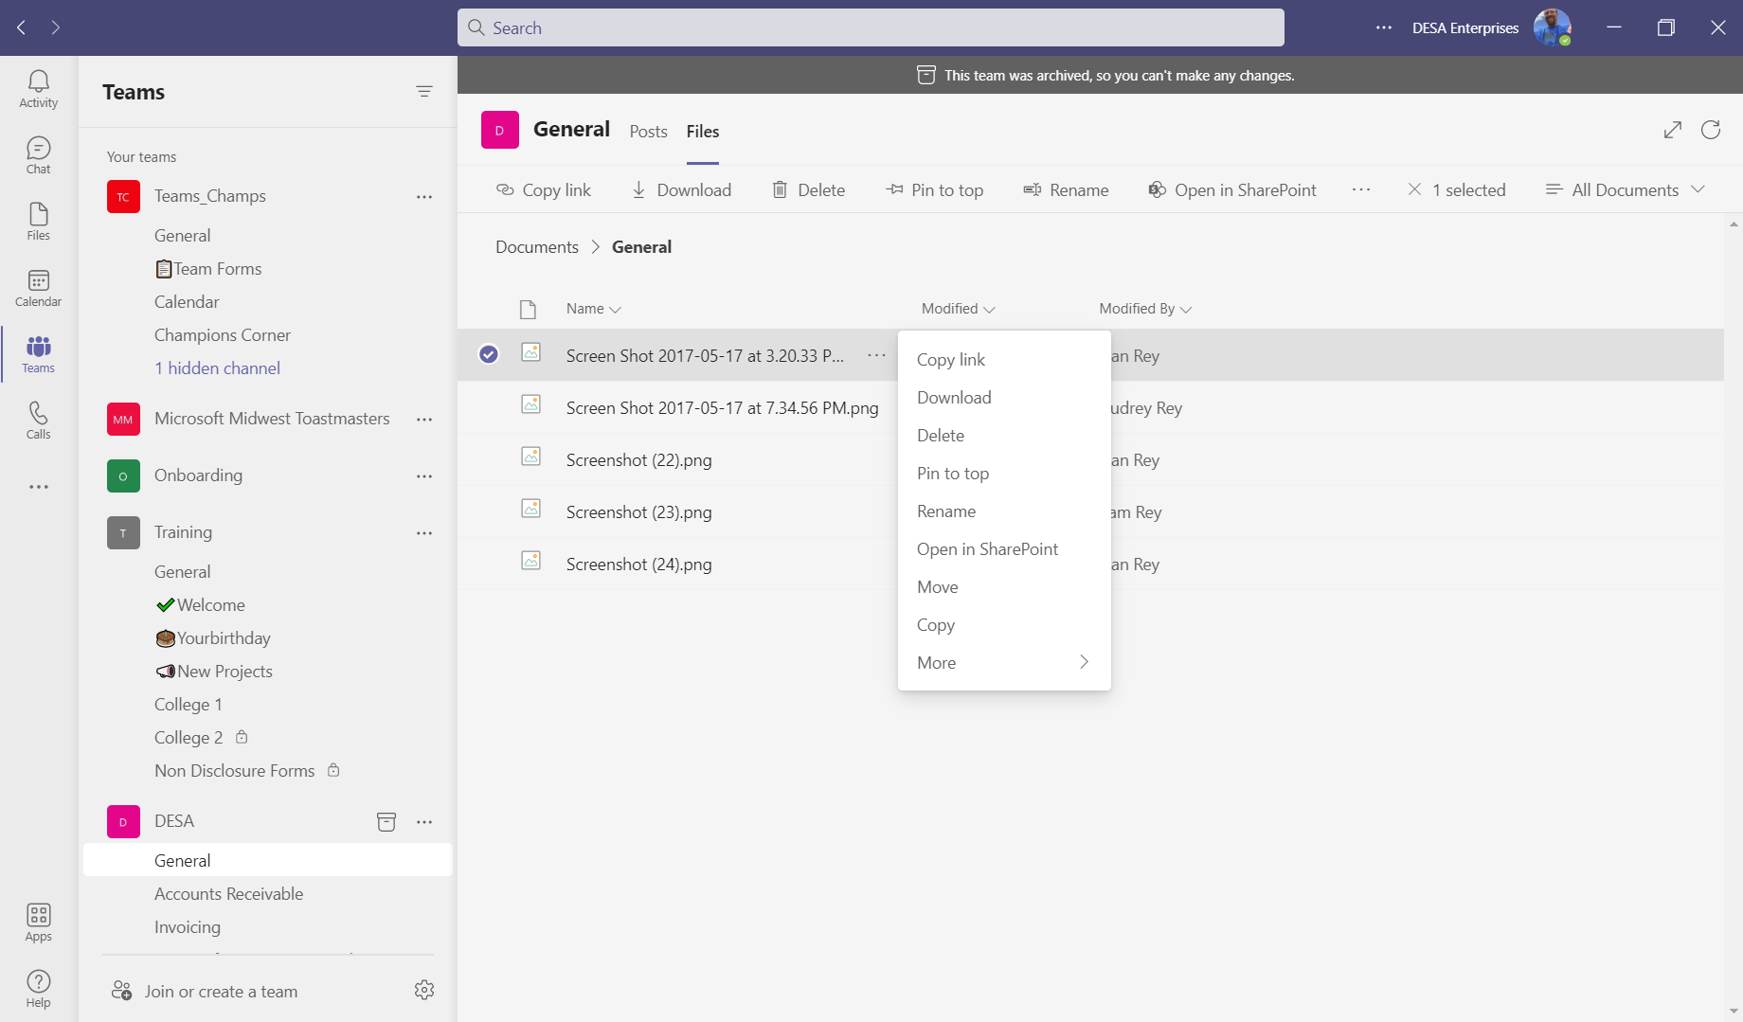
How to access a file from a team in SharePoint
A file is anything that isn’t text (photo, forwarded emails, document, video, etc.) and within a team, you will find it’s location under the files tab
DESA Enterprises, LLC
https://www.linkedin.com/company/desaenterprises
http://aka.ms/TipTuesday

Slide 32
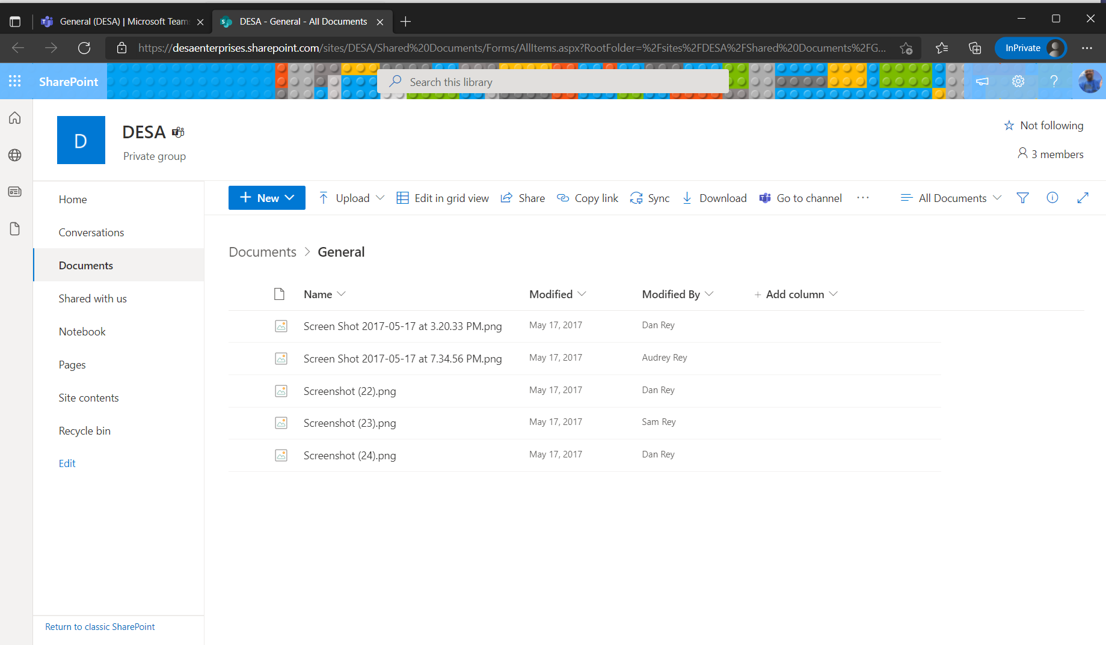
How to access a file from a team in SharePoint (cont)
DESA Enterprises, LLC
https://www.linkedin.com/company/desaenterprises
http://aka.ms/TipTuesday

Slide 33
Adding OneNote (or anything else) to a channel
Pinning items at the top of a channel is a best practice in Microsoft Teams
Depending on the users’ screen resolution/font size within Teams, tabs can and will eventually hide in the interface (under a More choice)
DESA Enterprises, LLC
https://www.linkedin.com/company/desaenterprises
http://aka.ms/TipTuesday

Slide 34
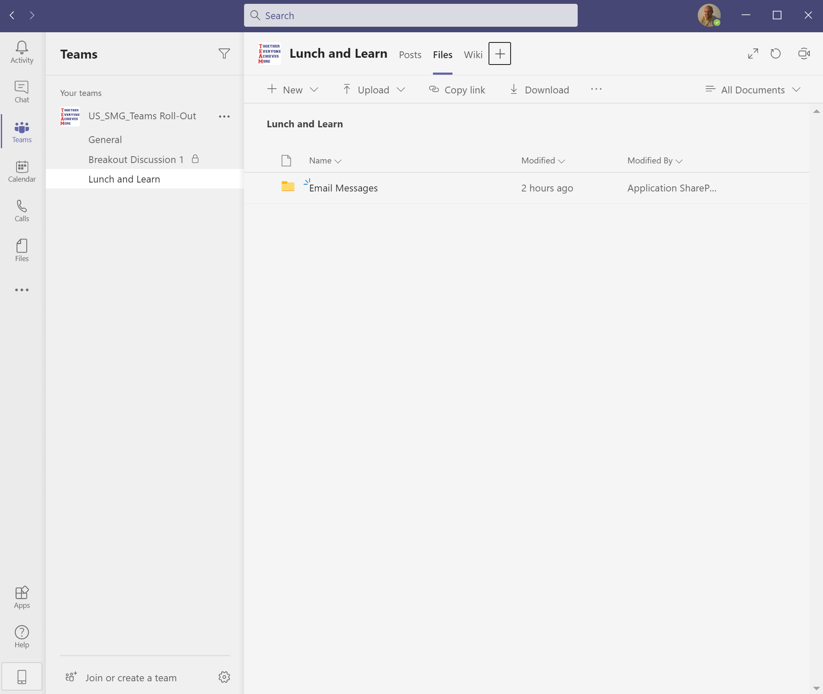
Adding OneNote (or anything else) as a Tab
DESA Enterprises, LLC
https://www.linkedin.com/company/desaenterprises
http://aka.ms/TipTuesday

Slide 35
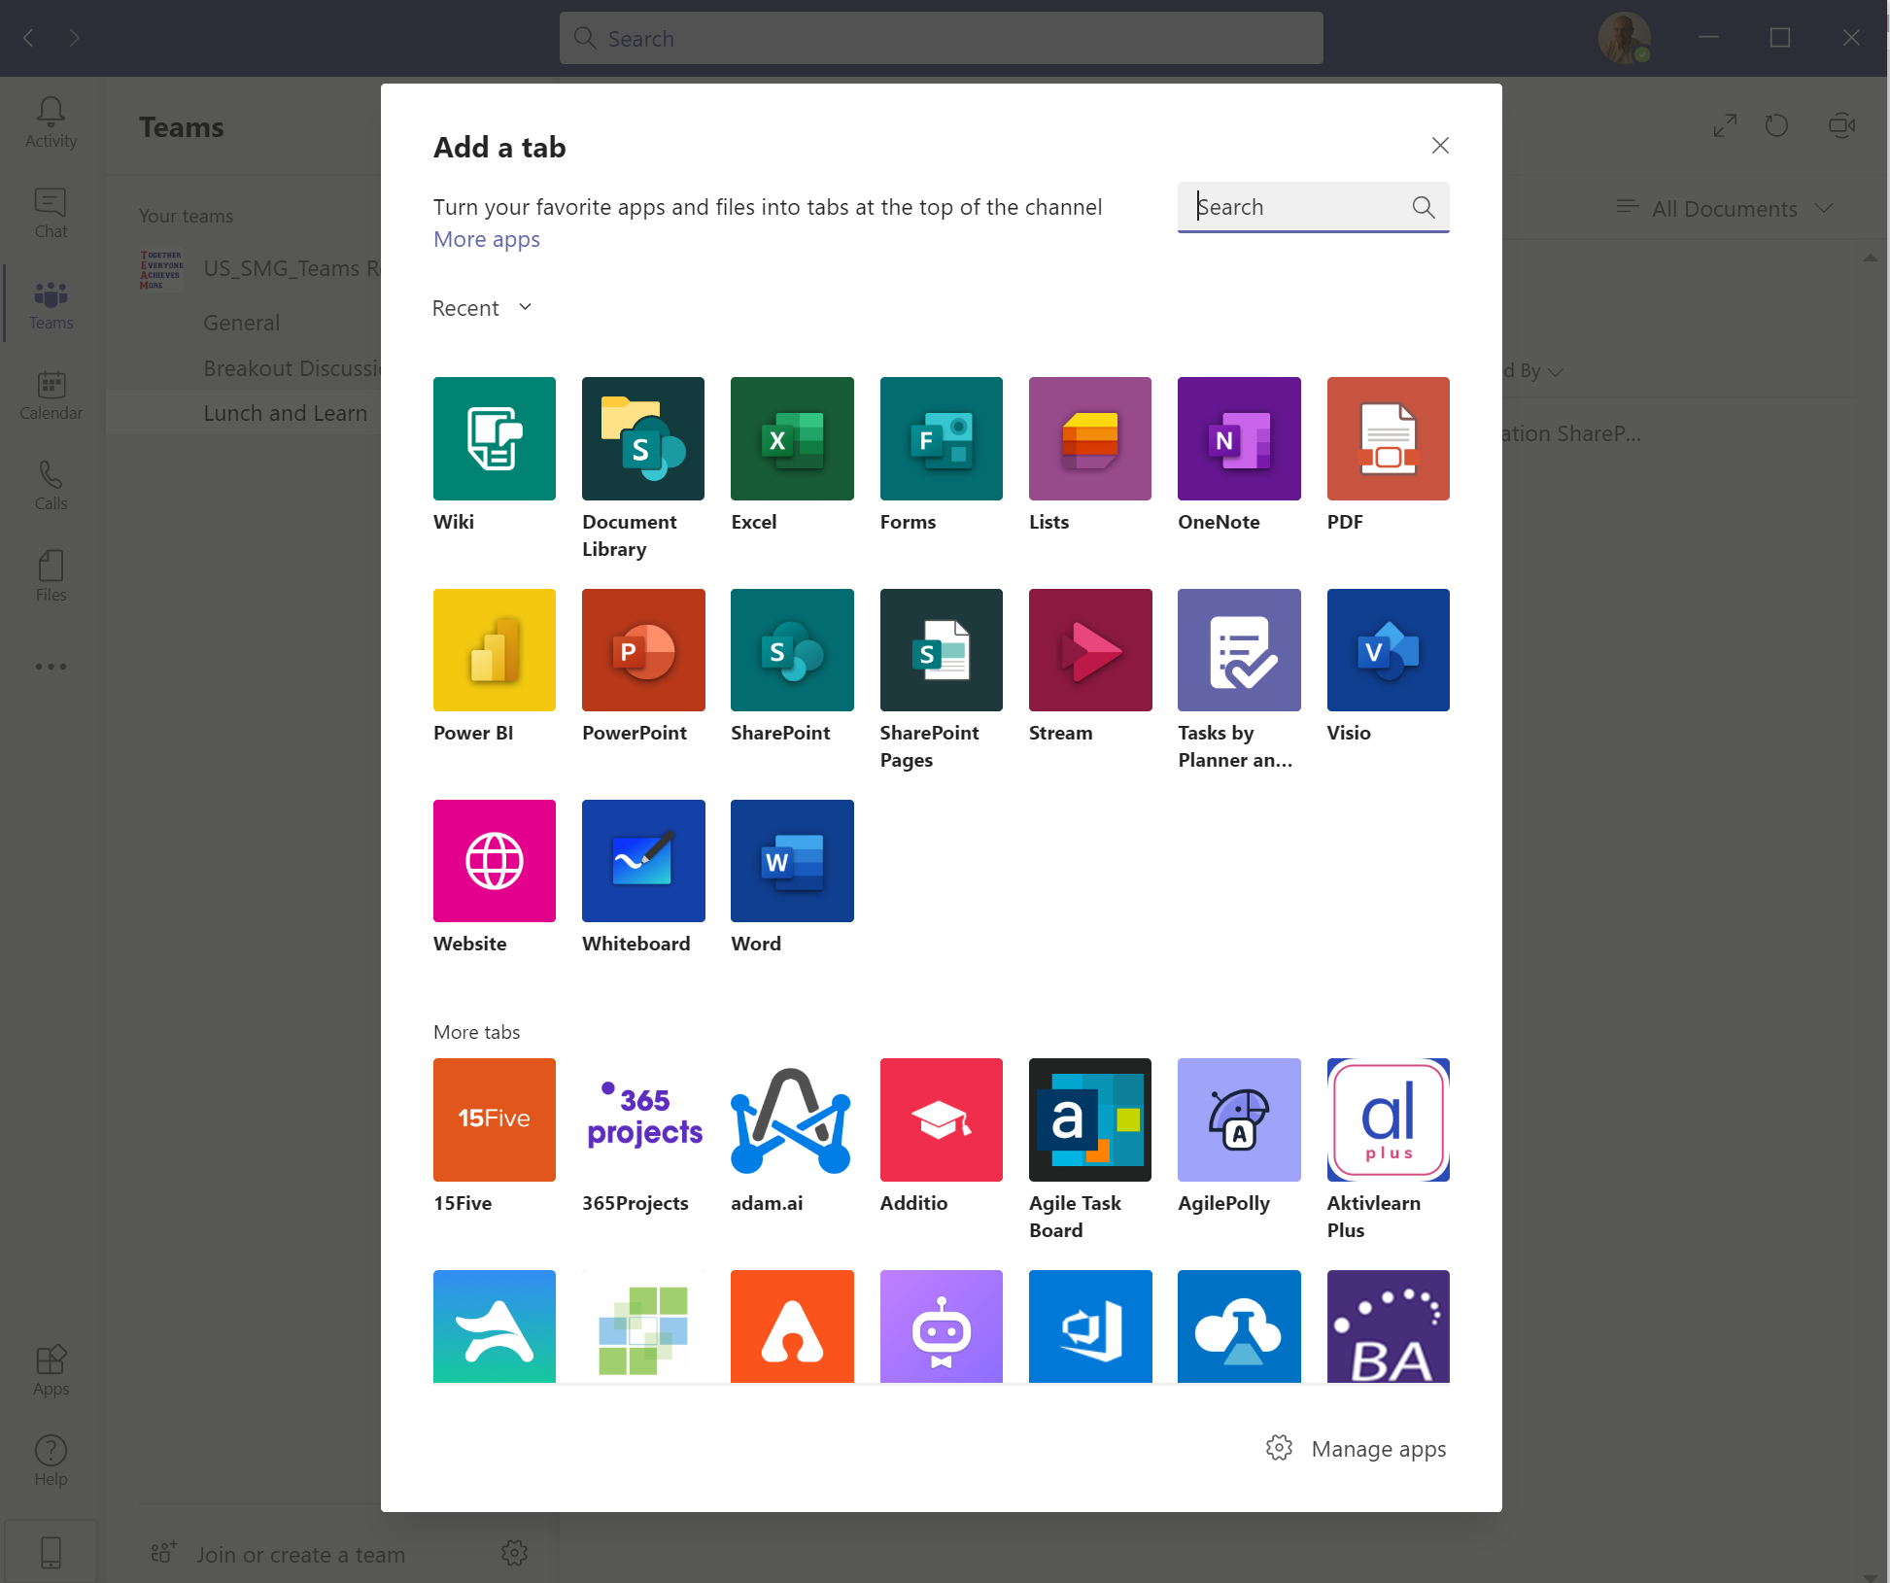
Adding OneNote (or anything else) as a Tab
DESA Enterprises, LLC
https://www.linkedin.com/company/desaenterprises
http://aka.ms/TipTuesday

Slide 36
Resources
http://aka.ms/TeamsAdoption
Microsoft 365 Roadmap | Microsoft 365 (Microsoft Teams filter)
DESA Enterprises, LLC
https://www.linkedin.com/company/desaenterprises
http://aka.ms/TipTuesday

Slide 37
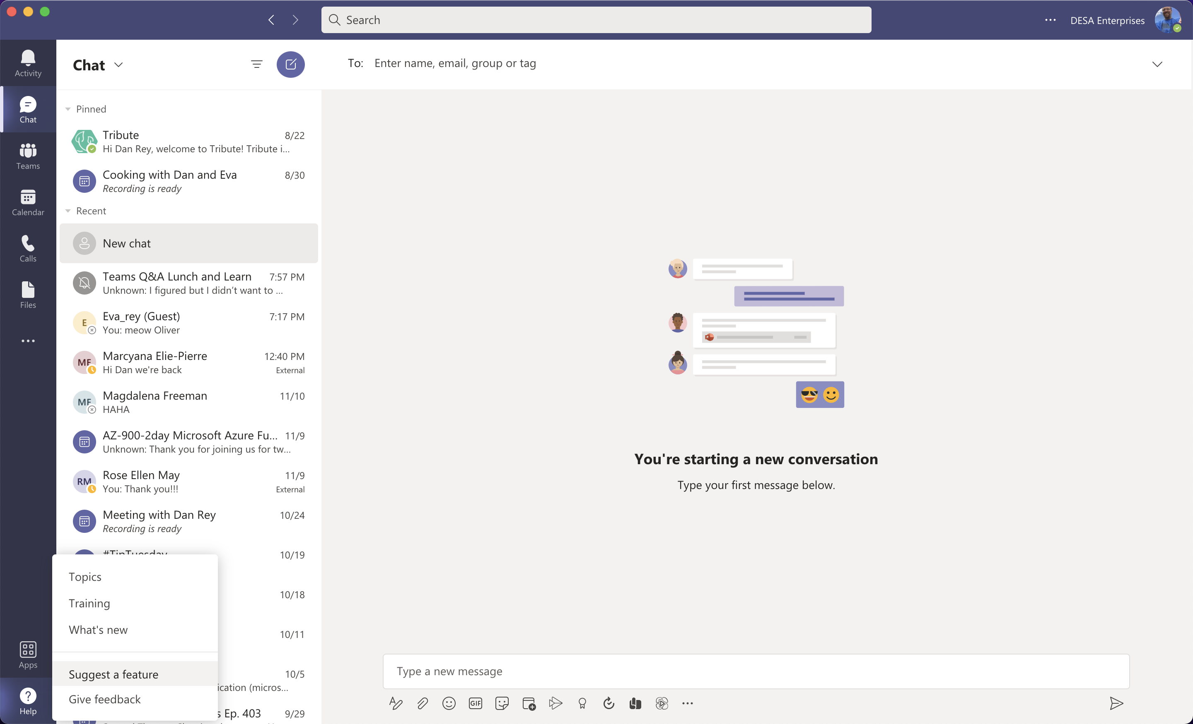
Help in the Lower Left – Topics, Training and What’s New
After this training, you can learn more right in the Microsoft Teams application! Remember we talked about keyboard shortcuts? Virtual backgrounds? Together Mode? High noise cancellation? Something else about meetings, chat, presenting, sharing? Help is there for you to search and learn more!
DESA Enterprises, LLC
https://www.linkedin.com/company/desaenterprises
http://aka.ms/TipTuesday

Slide 38
Help and Feedback Portal (Lower Left)
Lower left corner – Suggest a feature and Give Feedback (as well as help to use the application!)
DESA Enterprises, LLC
https://www.linkedin.com/company/desaenterprises
http://aka.ms/TipTuesday

Slide 39
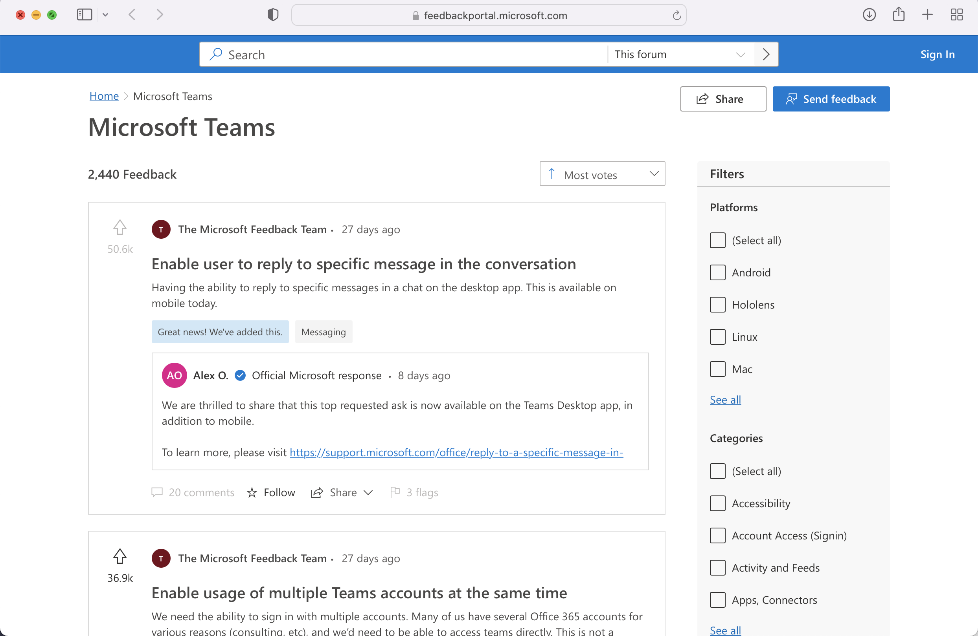
Feedback Portal
Microsoft is open for feedback on Microsoft Teams! Give them your feedback and crowdsource your feature (coworkers, colleagues, anyone can ”upvote” and get Microsoft’s attention on features YOU want to see in Microsoft Teams!)
DESA Enterprises, LLC
https://www.linkedin.com/company/desaenterprises
http://aka.ms/TipTuesday

Slide 40
Team Settings (Common)/FAQ from Users
Why am I seeing notifications for x (show how to turn them off/control them in chat, teams channels and in the notifications settings in Teams (operating system probably has settings for this too)
Font too large/small – don’t see the same options for pinned content/tabs, etc.
Pop out chats
Think they are in the app but they accessed Teams from SharePoint or the Office Portal in a browser
Navigation
Shortcut keys
How to turn off banner notifications and/or emails
Your phone/tablet can be a companion device within Teams!
DESA Enterprises, LLC
https://www.linkedin.com/company/desaenterprises
http://aka.ms/TipTuesday
Notes:
Add additional FAQ

Slide 41
Questions?
Thanks everyone!
DESA Enterprises, LLC
DESA Enterprises, LLC
https://www.linkedin.com/company/desaenterprises
http://aka.ms/TipTuesday

